Slide 1



PYTHON
FOR DATA SCIENCE
Eng.Mostafa Abdelzaher

Slide 2
WHY PYTHON FOR DATA SCIENCE?
Extensive Library Ecosystem
Performance & Scalability
Python provides a robust ecosystem of specialized libraries designed for every stage of the data pipeline
While Python is an interpreted language,
its data libraries are built on top of C.
This allows for:
Vectorized Operations:
Executing complex mathematical calculations
at high speeds.
Integration:
Seamless connection with Big Data tools
like Apache Spark and Hadoop.
Community & Support
A massive global community contributing to open-source projects.

Slide 3
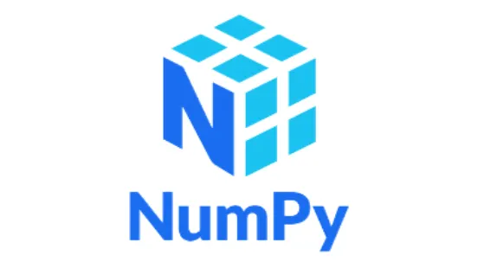

The Python Data Science Ecosystem
1. Data Manipulation & Analysis
library for scientific computing, providing high-performance N-dimensional array objects.
Enables complex mathematical operations on arrays
Provides powerful tools like DataFrames and Series for structured data manipulation and analysis.
Offers extensive functions for cleaning, merging, and reshaping datasets, making it the industry standard for ETL tasks.

Slide 4


The Python Data Science Ecosystem
2. Data Visualization
Matplotlib serves as the foundation for creating static, interactive, and animated 2D visualizations.
Seaborn is built on top of Matplotlib, providing a high-level interface for drawing attractive and informative statistical plots.

Slide 5


The Python Data Science Ecosystem
3. Data Acquisition
BeautifulSoup is designed for pulling data out of HTML and XML files by creating a navigable parse tree.
The Requests library simplifies the process of sending HTTP requests to servers to retrieve the raw web content.

Slide 6

The Python Data Science Ecosystem
3. Data Acquisition
Browser Automation:
Primarily used for automating web browsers to interact with dynamic content rendered via JavaScript.
Human Simulation:
Allows scripts to mimic human actions like clicking buttons or scrolling, which is essential for scraping modern web applications.

Slide 7


The Python Data Science Ecosystem
4. Scientific Computing & ML
Built on top of NumPy to provide a large collection of mathematical algorithms for integration, optimization, and signal processing.
The most robust and popular library for classical Machine Learning, featuring tools for classification, regression, and clustering
Built on NumPy, SciPy, and Matplotlib, it provides a consistent and efficient API for data mining and predictive data analysis

Slide 8


The Interactive Environment
What is IPython? (The Engine)
What is Jupyter Notebook? ( Interface)
IPython (Interactive Python)
is an advanced command-shell and a kernel for Jupyter that provides a powerful interface for interactive computing.
An open-source web application that allows you to create and share documents containing live code, equations, visualizations, and narrative text.
The Concept: It acts as a wrapper around the IPython Kernel, providing a "Notebook" structure for iterative data exploration.

Slide 9




Data Science Frameworks & Alternatives
1. Cloud-Based Solutions (Zero Setup)
2. Local
built on Jupyter, and integrated with Google Drive.
VS Code (with Jupyter Extension): The best "Hybrid" solution, combining traditional coding with notebook cells.
Optimized for data science competitions with pre-installed libraries and datasets.
3. Distribution Platforms
Anaconda:
The most popular distribution that simplifies package management and deployment for scientific computing.

Slide 10
Jupyter notebook
التعامل مع الخلايا (The Cell System)
الخلايا نوعان:
Code Cell: لكتابة أكواد البايثون .
Markdown Cell: لكتابة الشرح، العناوين، وال(Documentation).
أهم الاختصارات :
Shift + Enter: تشغيل الخلية الحالية والانتقال للتي تليها.
Ctrl + Enter: تشغيل الخلية الحالية والبقاء فيها.
A: إضافة خلية بالأعلى (Above).
B: إضافة خلية بالأسفل (Below).
M: تحويل الخلية من كود إلى Markdown (للشرح).
Y: تحويل الخلية من Markdown إلى كود.
يتم حفظ الملف بصيغة .ipynb
(وهو اختصار لـ Interactive Python Notebook).

Slide 11
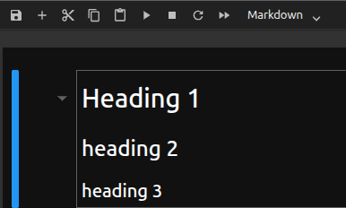
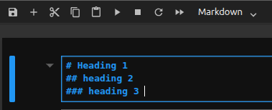
Jupyter notebook
Write a Professional MarkDown
Headings

Slide 12
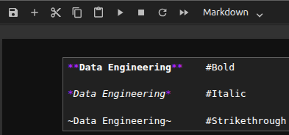
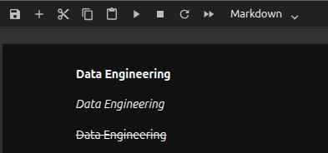
Jupyter notebook
Write a Professional MarkDown
Text Styling

Slide 13
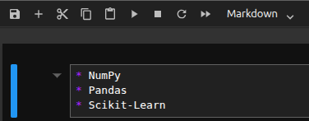
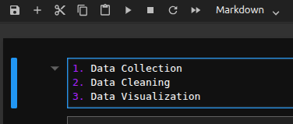
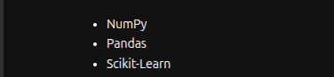
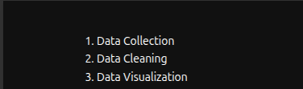
Jupyter notebook
Write a Professional MarkDown
Lists
Bulleted List
Numbered List

Slide 14
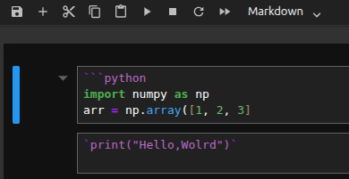
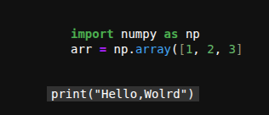
Jupyter notebook
Write a Professional MarkDown
Code Snippets
أحياناً نحتاج لكتابة كود للشرح فقط دون تنفيذه
للكلمات البسيطة: نستخدم الـ Backtick ` `
كود كامل: نستخدم ثلاث علامات Backtick مع اسم اللغة
علامة ال backtick ` ` حرف حرف ال ذ في الكيبورد الزر اسفل ال esc

Slide 15
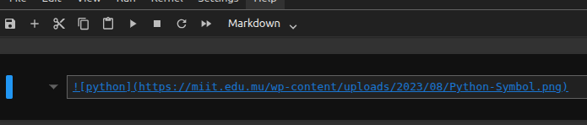

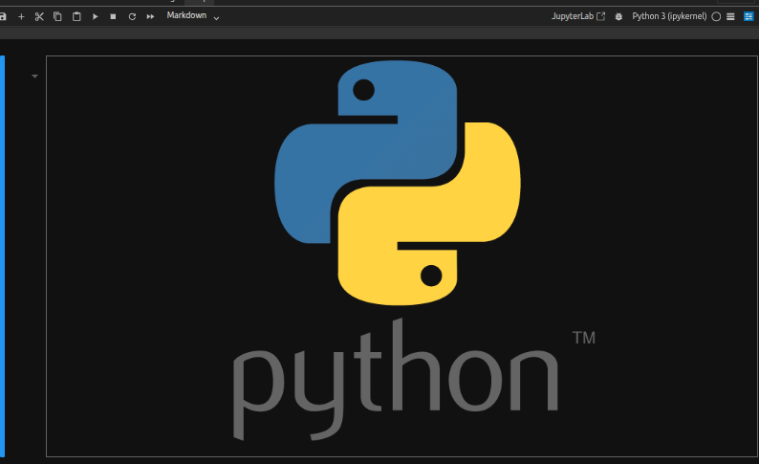
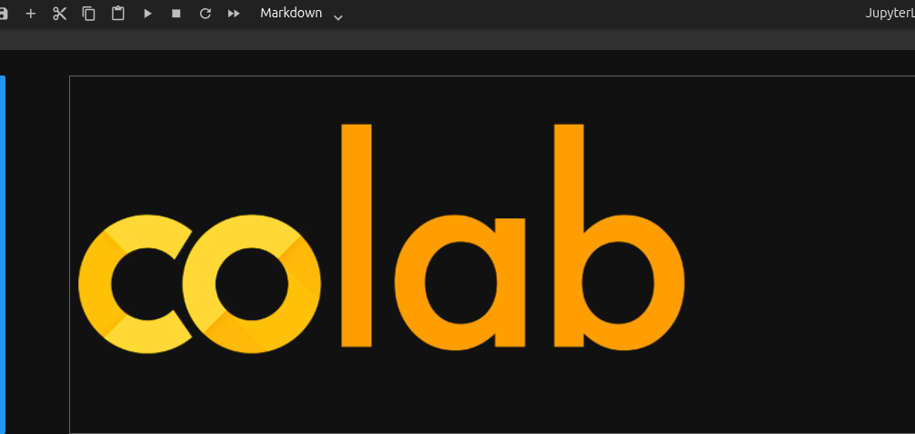
Jupyter notebook
Write a Professional MarkDown
Links & Images
رابط: (URL) [Text] !
صورة: (Image_URL_or_Path) [Alt Text]!

Slide 16
Deep Dive into NumPy
Why NumPy over Python Lists?
Memory Efficiency:
NumPy arrays are stored in Contiguous Memory blocks, leading to much smaller memory footprints compared to standard Python lists.
Vectorized Operations:
It eliminates the need for explicit for loops by performing operations on entire arrays at once via C-level implementation

Slide 17
Deep Dive into NumPy
The N-Dimensional Array (NDArray)
Homogeneous Data:
Unlike lists, all elements in a NumPy array must be of the same data type, which allows for highly optimized mathematical computations.
Broadcasting:
A powerful mechanism that allows NumPy to work with arrays of different shapes during arithmetic operations

Slide 18
Deep Dive into NumPy
Performance Benchmark
Operations in NumPy can be 10x to 100x faster than native Python code for large datasets, which is crucial for Big Data applications.

Slide 19
Deep Dive into NumPy
ال CPU يتعامل مع ال list على انها reference للقيم فقط وليس مكان تخزينها
Python lists vs. numpy arrays
بايثون تتعامل مع الـ List كأنها مصفوفة تحتوي على عناوين (Pointers).
الـ List لا تخزن القيم نفسها بجانب بعضها، بل تخزن عناوين أماكن القيم في الذاكرة.
المشكلة عندما تريد الوصول لعناصر القائمة، يجب على المعالج (CPU) أن يذهب للعنوان الأول، ثم يرتد لمكان القيمة، ثم يعود للعنوان الثاني، ثم يرتد لمكان القيمة... وهكذا. هذا يسمى Pointer Overhead.
ستكون النتيجة استهلاك أكبر للذاكرة وبطء شديد في العمليات الحسابية لأن البيانات مبعثرة (Scattered).
تذكر ان كل عنصر في بايقون هو في الاصل object مما يفسر بطء التنفيذ وال overhead

Slide 20
Deep Dive into NumPy
Python lists vs. numpy arrays
الـ NumPy Array هو Contiguous Memory Block.
تُخزن القيم في بلوك واحد متصل في الذاكرة، كما في لغة C أو C++.
الميزة ان المعالج عندما يقرأ العنصر الأول، يجد العناصر التالية جاهزة خلفه مباشرة. هذا يسمح باستخدام تقنيات اخرى حيث ينفذ المعالج عملية حسابية واحدة على مجموعة أرقام في نفس اللحظة.
و النتيجة كفاءة عالية في السرعة وتوفير كبير في الذاكرة لأننا لا نخزن "عناوين" بل نخزن "بيانات" فقط.

Slide 21
Deep Dive into NumPy
NumPy Overview
Arrays
Shaping and transposition
Mathematical Operations
Indexing and slicing
Broadcasting

Slide 22
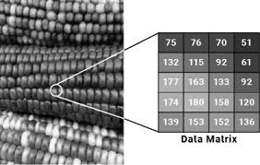
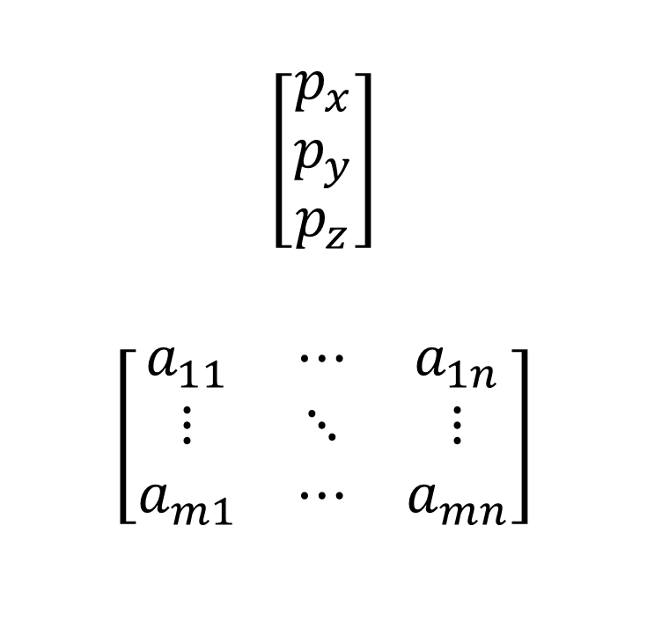
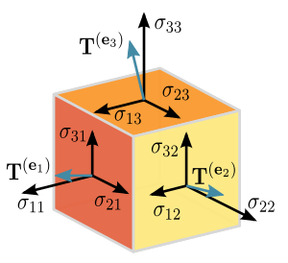
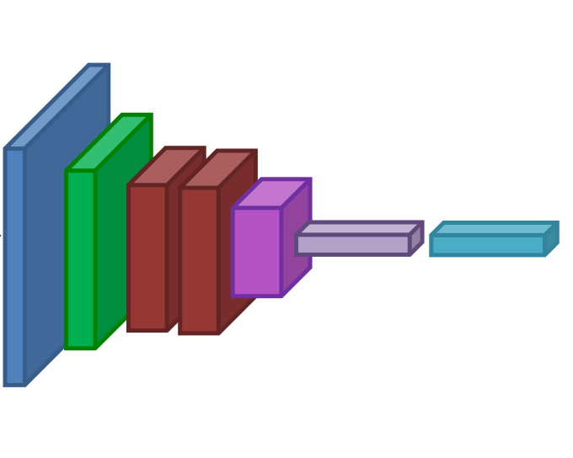
Deep Dive into NumPy
NumPy Overview
Arrays
Structured lists of numbers.
Vectors
Matrices
Images
Tensors
ConvNets

Slide 23
Deep Dive into NumPy
Basic Properties
Arrays can have any number of dimensions, including zero (a scalar).
Arrays are typed: np.uint8, np.int64, np.float32, np.float64
np.ones , np.zeros
np.arange
np.concatenate
np.astype
np.zeros_like, np.ones_like
np.random.random

Slide 24
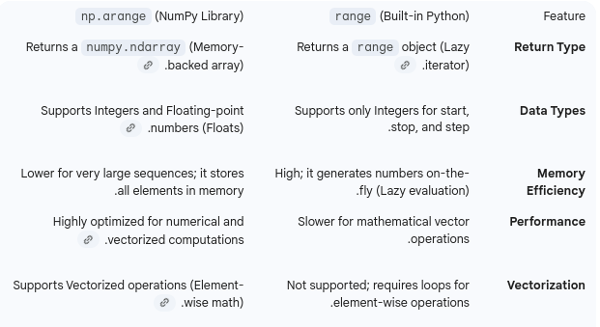
Deep Dive into NumPy
The difference between arange & range

